Slide 1
ACL

Slide 2
Reviewing the basics
The Linux filesystem gives us three types of permissions. Here is a simplified review:
User (or user owner)
Group (or owner group)
Other (everyone else)
With these permissions, we can grant three (actually five, but we’ll get to that in a minute) types of access:
Read
Write
eXecute
These levels of access are often adequate in many cases. Say that you have a directory where files from the accounting department live. You might set these permissions to:
drwxrwxr-x 2 admin admin 12 Jan 8 15:13

Slide 3
What is ACL ?
Access control list (ACL) provides an additional, more flexible permission mechanism for file systems. It is designed to assist with LINUX file permissions. ACL allows you to give permissions for any user or group to any disc resource.

Slide 4
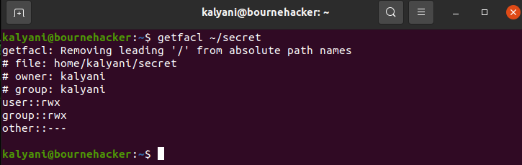
Viewing the current ACL

Slide 5
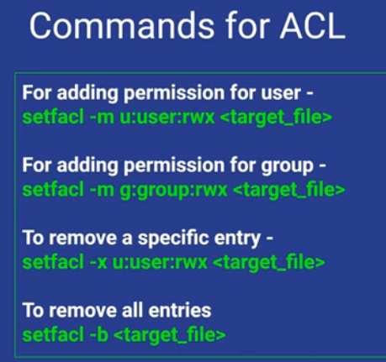

Slide 6
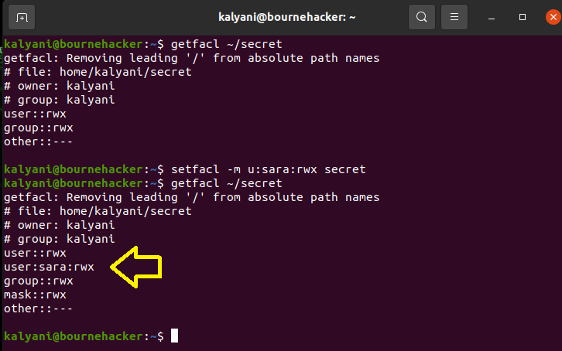
Setting an ACL
setfacl -m u:sara:rwx secret

Slide 7
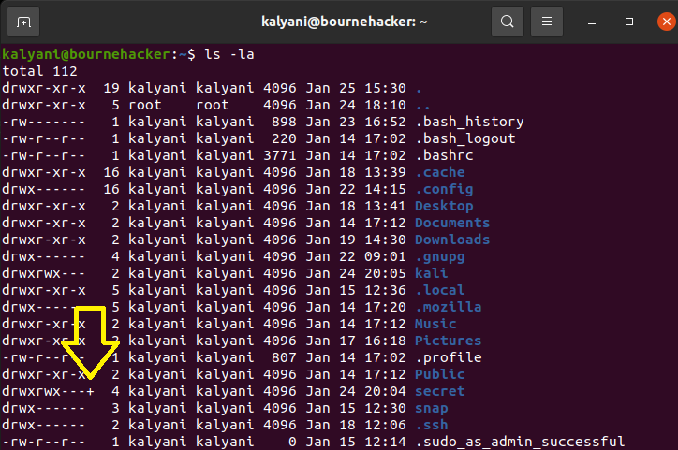

Slide 8
Assigning groups fine-tuned permissions
Much like assigning users special permission, we can assign groups special permission as well. What this means is that we can keep our base permissions as is and assign a particular group additional permission using ACL.
setfacl -m g:john:r secret

Slide 9
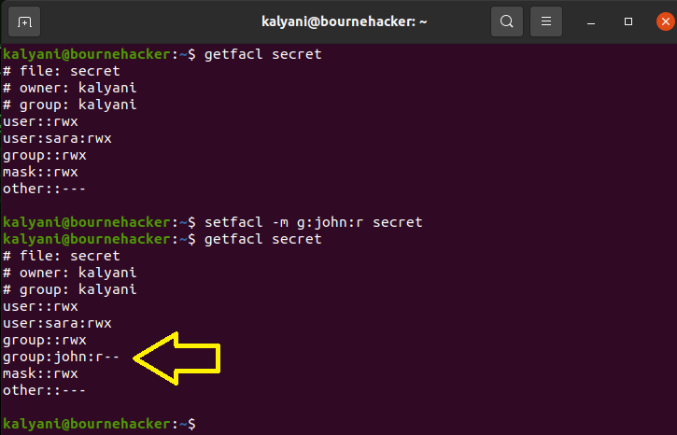

Slide 10
Commands for ACL
For adding permission for user in all the files inside a folder
Setfacl –Rm “entry” <target_Folder>

Slide 11
Deleting fine-tuned permissions
You may also wish to revoke the permissions given, and that is just as easy to do as giving them. You use the -x switch instead of the -m switch to revoke the permissions.
To remove a specific entry:
setfacl -x u:username filename setfacl -x g:group_name filename
In this case, I would have written:
setfacl -x u:sara secret

